Slide 1

Will the levitation
become commonly used?
Raman Haivaronski AC-43I

Slide 2
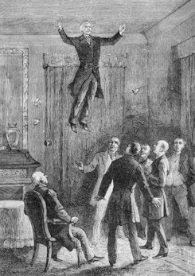
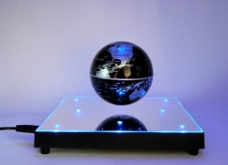
Levitation is the process by which an object is held aloft, without mechanical support, in a stable position.

Slide 3
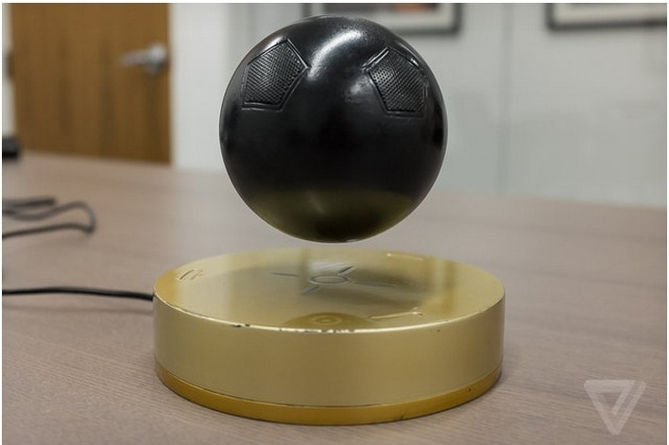
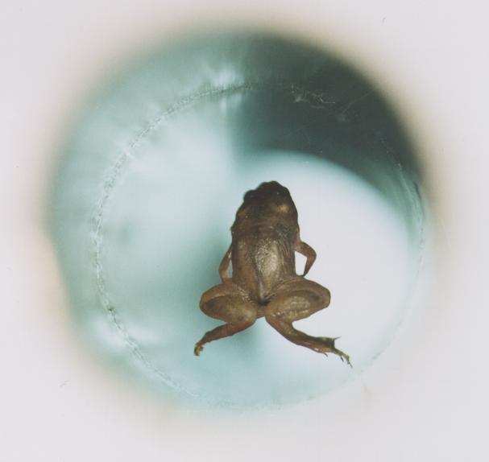
There're a lot of types of levitation. For example, using diamagnetic levitation we can make the frogs fly. There are also such types of levitation such as acoustic levitation and optic levitation.

Slide 4
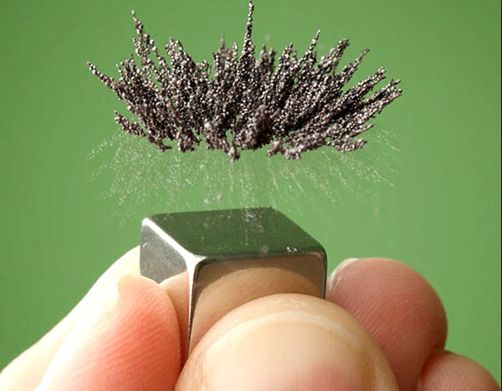
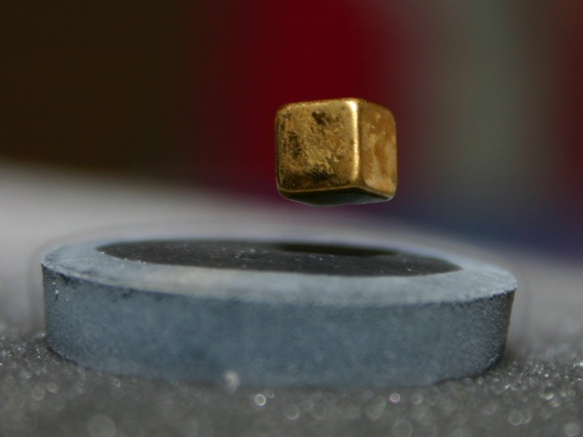
A cubical magnet levitating over a superconducting material (known as the Meissner effect),

Slide 5

It seemed to be fantastic 20 years ago.

Slide 6
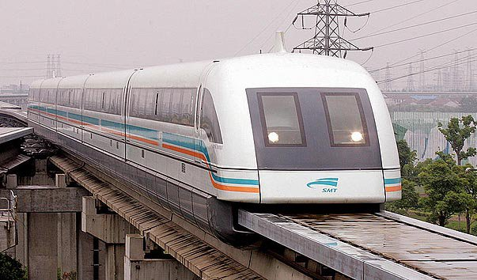
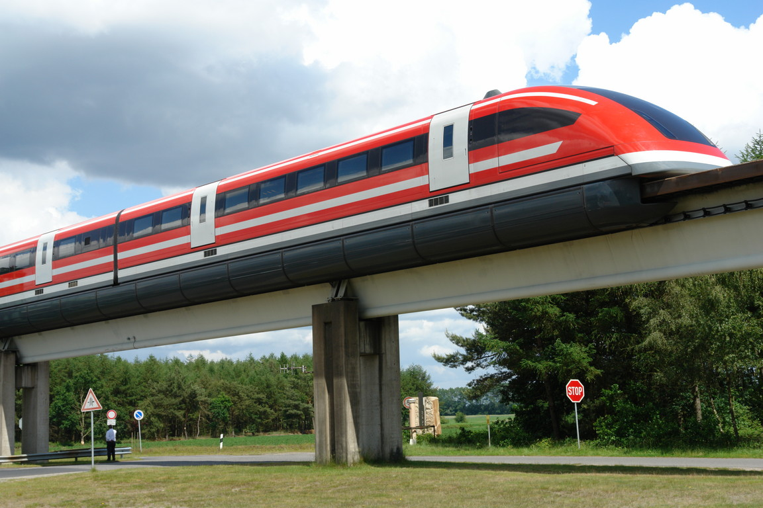
But today it's a reality. As an example let’s take maglevs as one of the most useful inventions that use levitation.

Slide 7
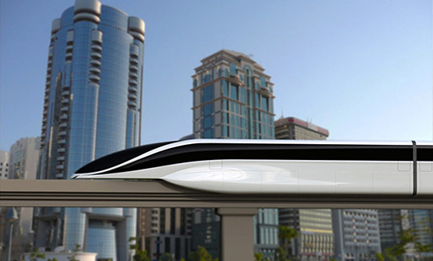
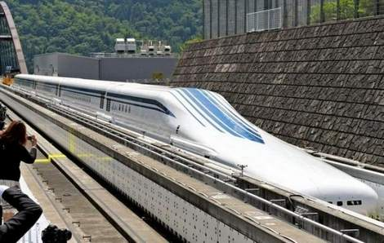
Magnetic levitation is already actively used in transport systems of Japan, Germany, South Korea, China.

Slide 8
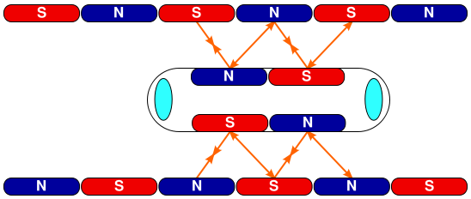
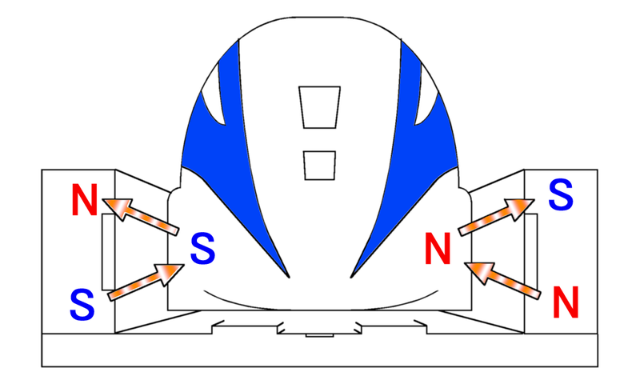
The basic principle of magnetic poles attraction and repulsion is used.

Slide 9
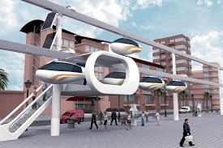
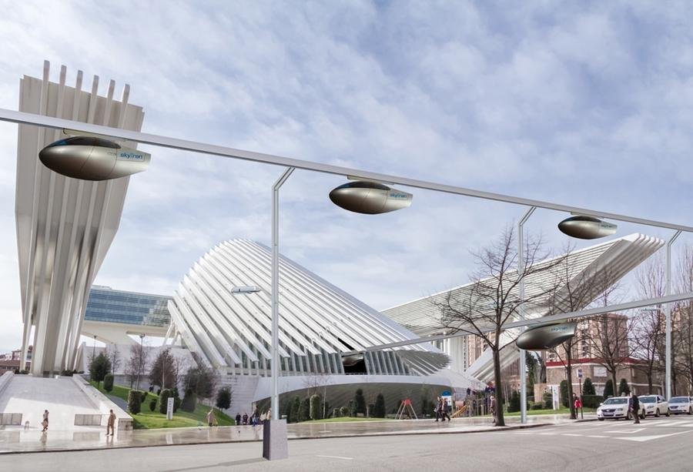
SkyTran is a patented, high-speed, low-cost, elevated system created by NASA. The system is now being tested in Tel-Aviv, Israel.

Slide 10
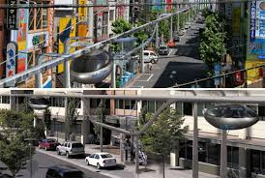
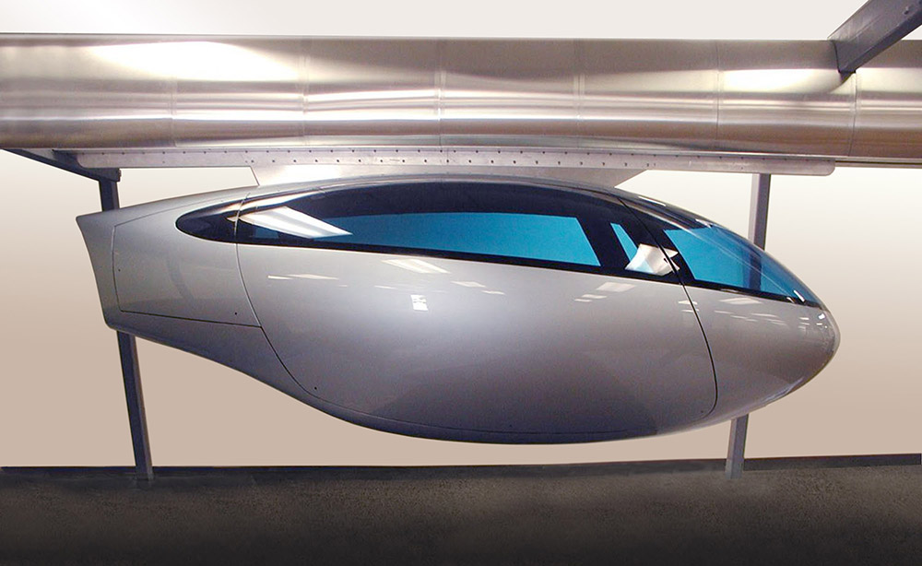
skyTran moves passengers in a fast, green, and economical manner. skyTran would be made safer than driving by eliminating human error.

Slide 11
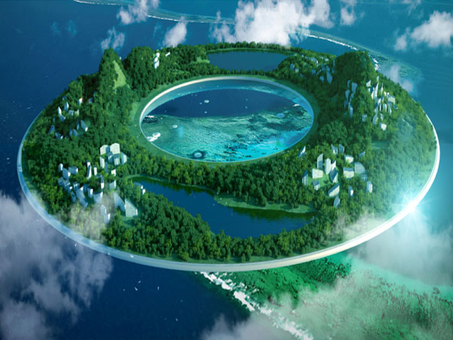
Magnetically levitated city is a concept of Chinese designer Wei Zhao of future human cities.

Slide 12
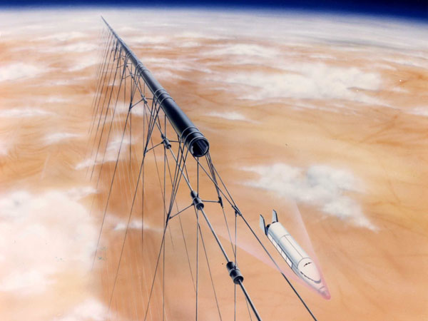
Maglev space launch system was researched by NASA but the cost of such track is too much ($20 billions).

Slide 13

That's how the magic of levitation is becoming a reality nowadays.

Slide 14
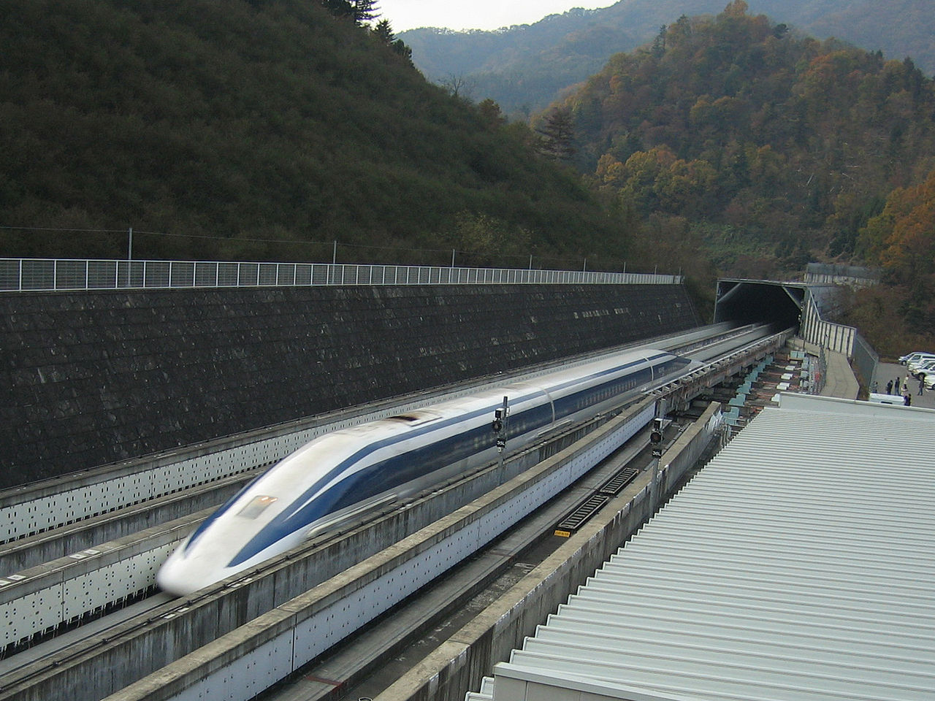
I want to conclude with an interesting fact: JR-Maglev MLX01 is the current Guinness record holder for train speed with the record of 603 km/h.

