Slide 1
Ministry Of Education Republic Of Belarus Brest State Technical University DEPARTMENT OF INTELLIGENCE INFORMATION Group AS-40I Name-Nicholas Ajuru

Slide 2
Abstract:
2015 is like to be a year of contrasts in which a difficult and uncertain start will most probably give way to a promising end, as renewed post-election economic reform effects to address fiscal, structural, and financial challenges highlighted by low oil price and weak capital inflows on the eve of election will open up new growth and investment opportunities, thereby brightening the outlook.

Slide 3
Thus, while the twin external shocks on the eve of general elections had imposed short term challenges and created significant uncertainties about the economic outlook in 2015, they have also beneficially elevated the place of economic and fiscal reforms in the pre-election conversation. A strong consensus for reforms has fortuitously been built among the populace that it makes sense to expect a high pace of reforms after the election.

Slide 4
This will brighten the outlook for the second half of 2015 and beyond. Specifically the three big gains within Nigeria’s reach are: (a.) Nigeria’s fiscal outlook can easily be stabilized by revenue reforms that provides the fiscal space required for growth and stability; (b.) Breaking government monopoly in key potentially large economic sectors and allowing entry of reputable private firms will release fresh growth and investment impetus; (c.) Foreign longer-term financial inflows that will be attracted to the liberalized sectors will reduce Nigeria’s dependence on volatile short term capital inflows.

Slide 5
Nigeria is clearly coming up with a better contemplation of her economic and financial future, and it should be easier to engage others to come and invest in that future.

Slide 6
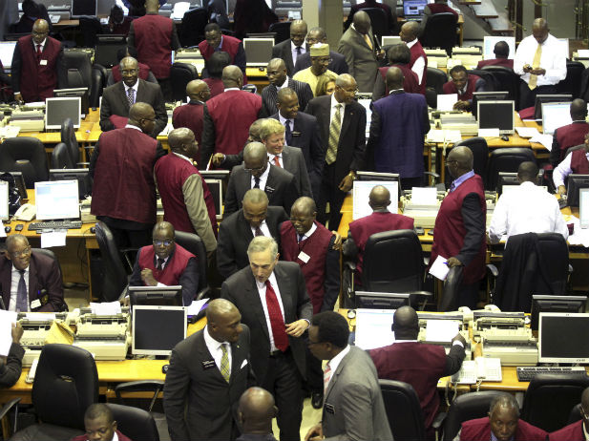
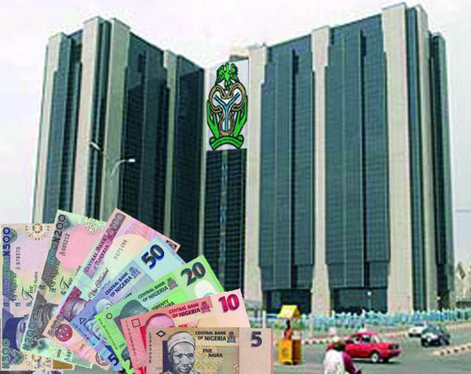
Economic Outlook and Capital Outflow

Slide 7
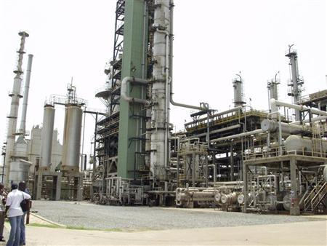
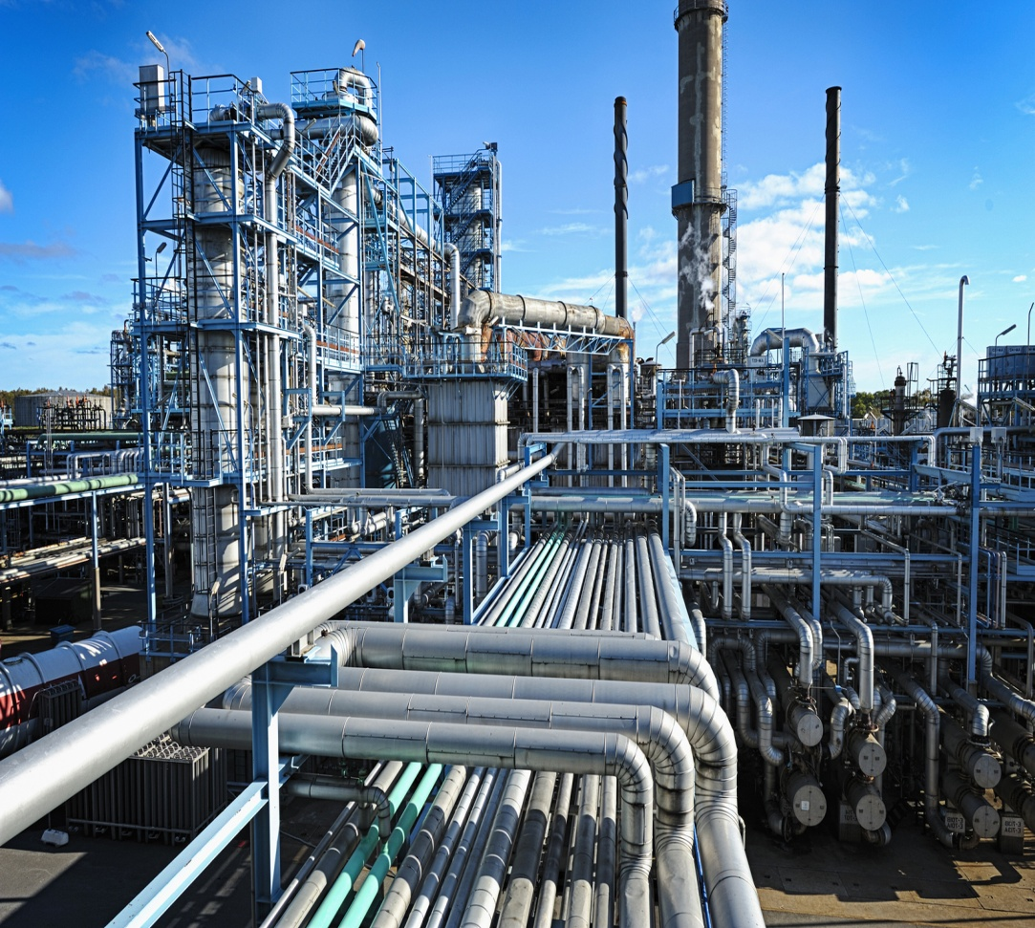
External Reserves and Oil Price Shock

Slide 8
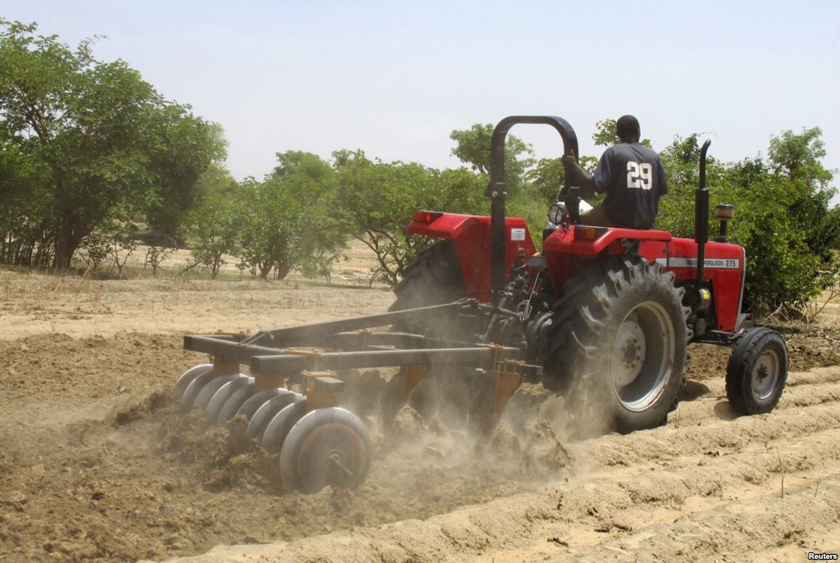
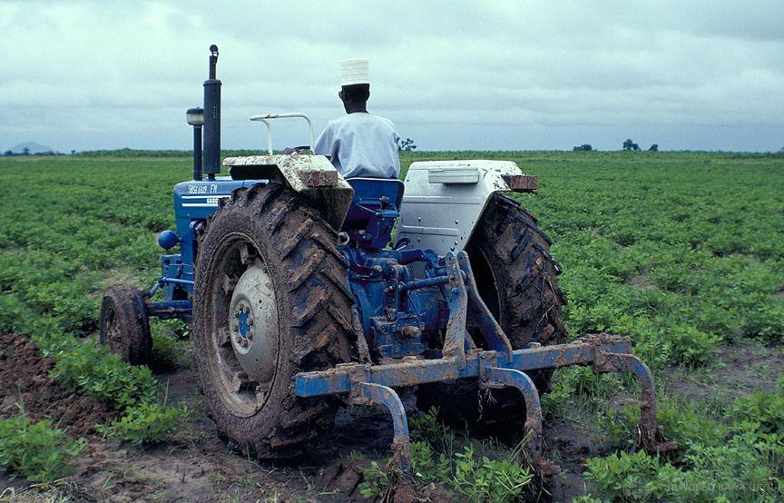
Agricultural production and Fiscal reform

Slide 9
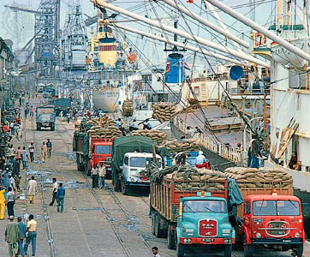
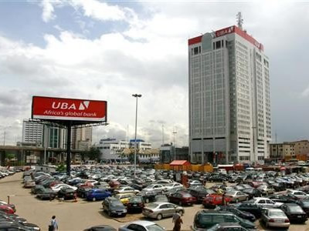
External Reserves and the Port Authority

Slide 10
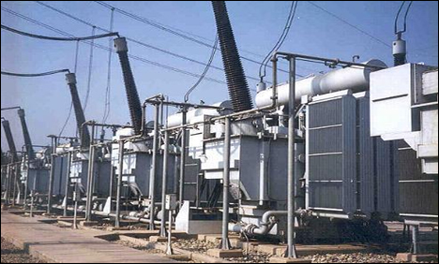
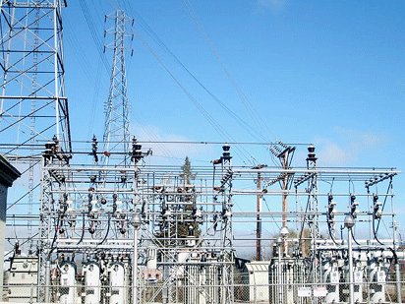
Power plant project and Power transmission

Slide 11
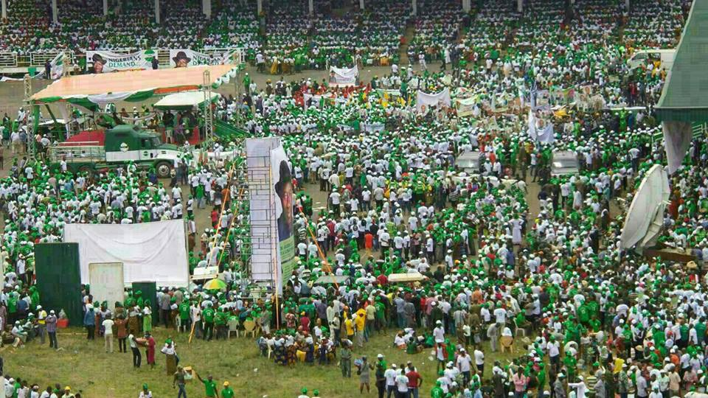
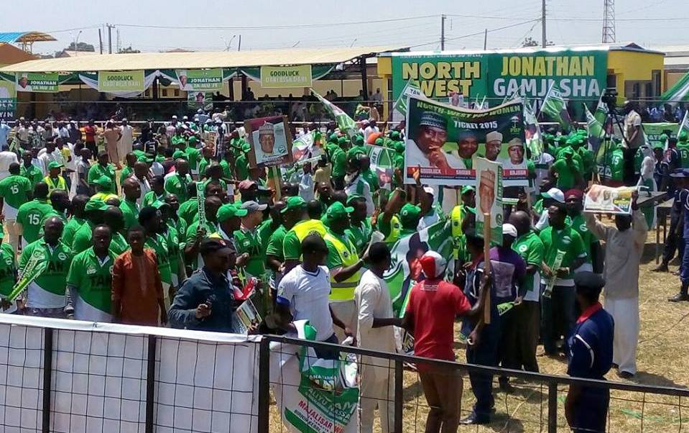
Pre-election conversation and Consensus for reform

Slide 12
Keywords: Nigeria, 2015, Uncertainty, Country Risk, General Election, Oil Price Shock, Capital Outflow, External Reserves, Economic Outlook, Uncertainty, Pre-election conversation, Consensus for reform, Fiscal reform, Rail liberalization

